Slide 1


Slide 2


Slide 3
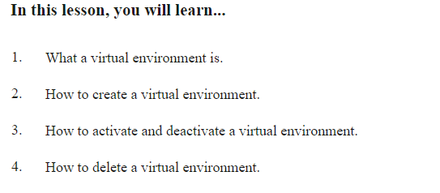
Virtual Environments

Slide 4
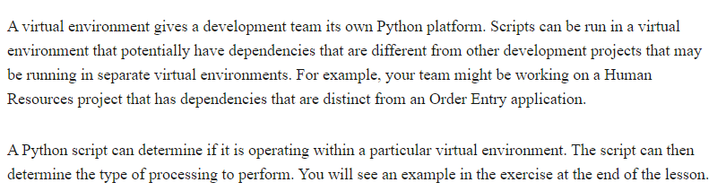
Virtual Environment

Slide 5
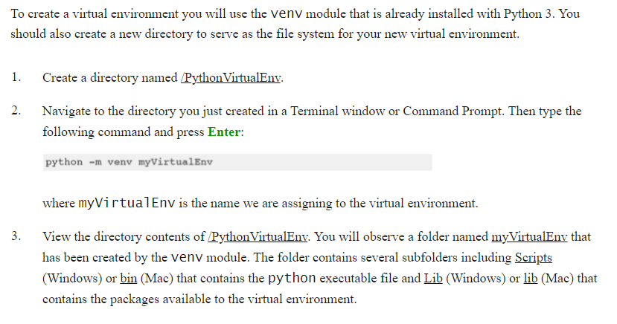
Creating a Virtual Environment

Slide 6
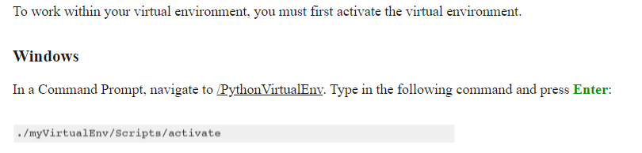
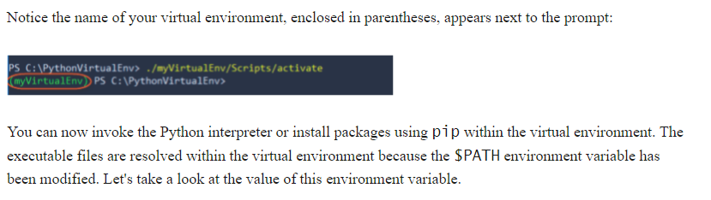
Activating and Deactivating

Slide 7
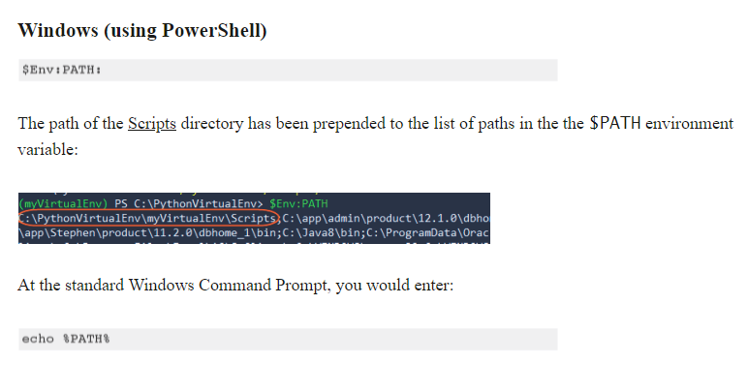
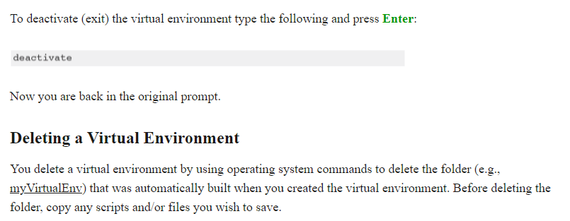

Slide 8
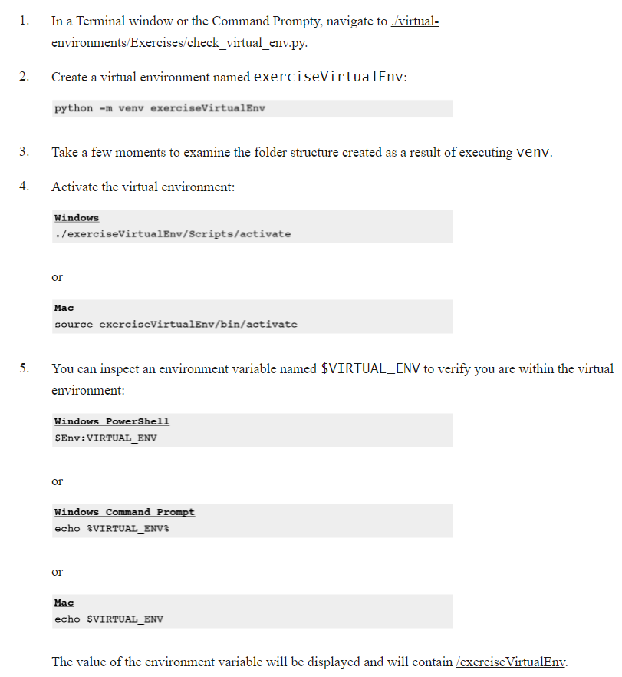
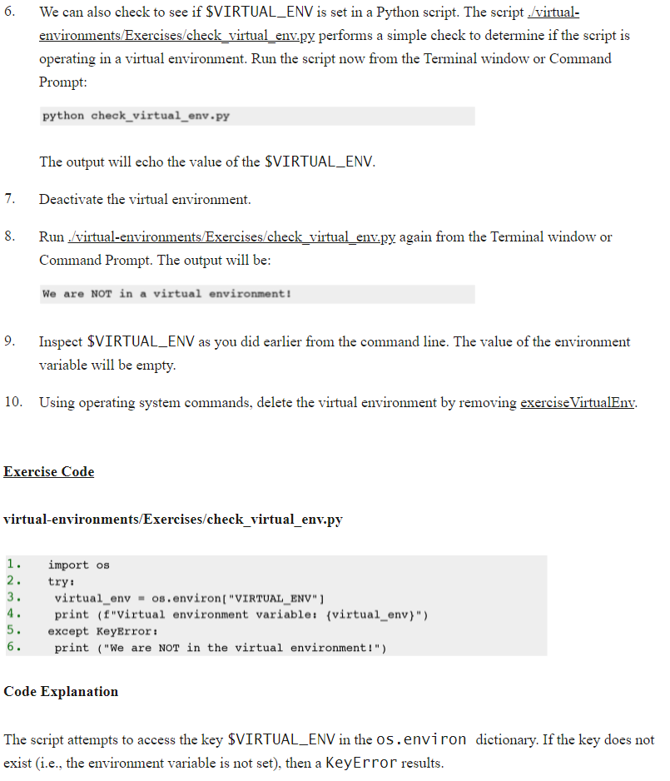
Exercise 23: Working with a V Env

Slide 9


Slide 10
Regular Expressions (REGEXP)
Also called pattern matching
A way to find occurrences of a certain word, letter etc in a string
Based on wildcards
Always consists of
What are you looking for?
How many times does it need to occur?

Slide 11
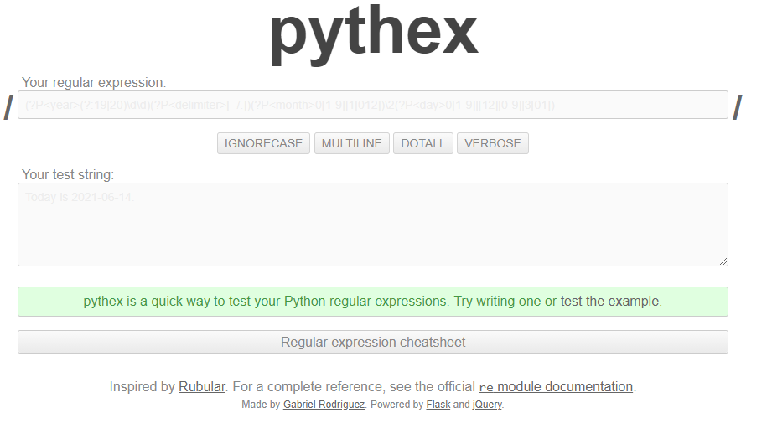
https://pythex.org/

Slide 12
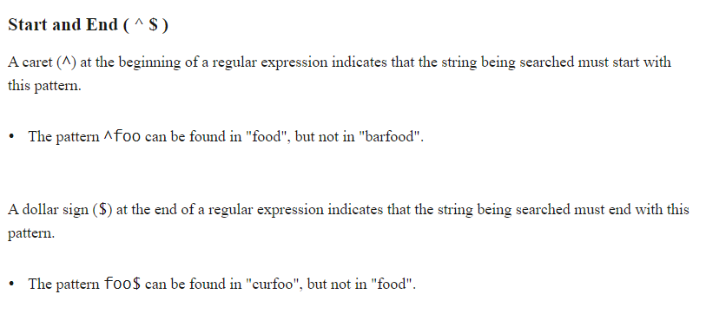
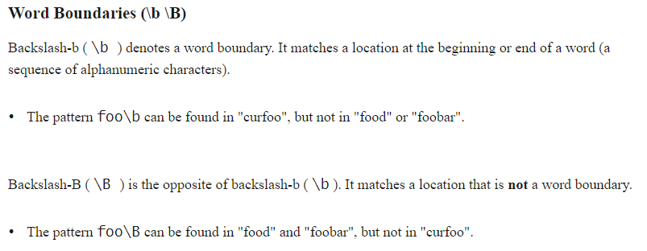

Slide 13
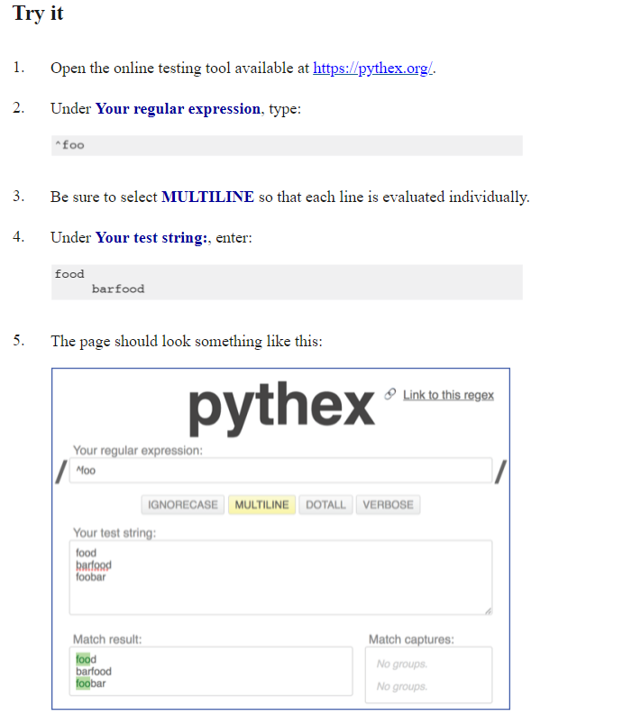

Slide 14
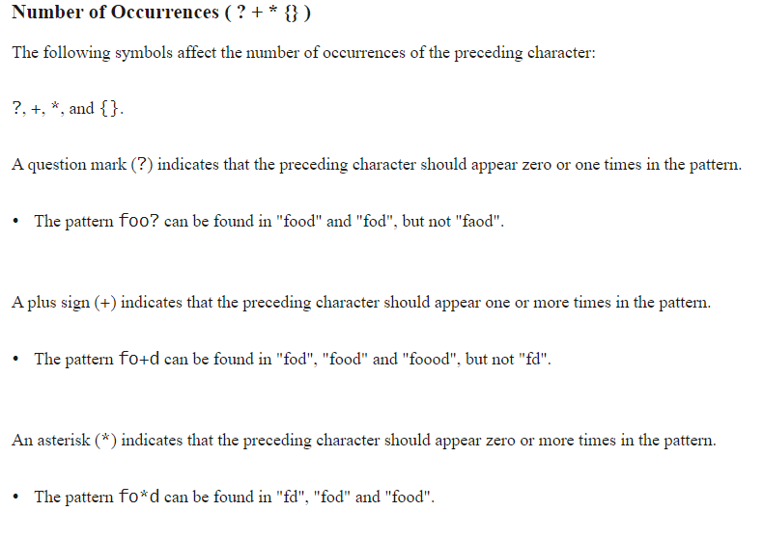

Slide 15
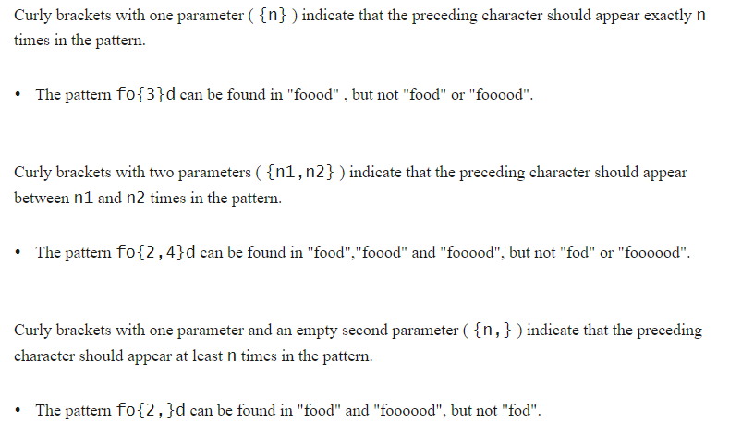

Slide 16
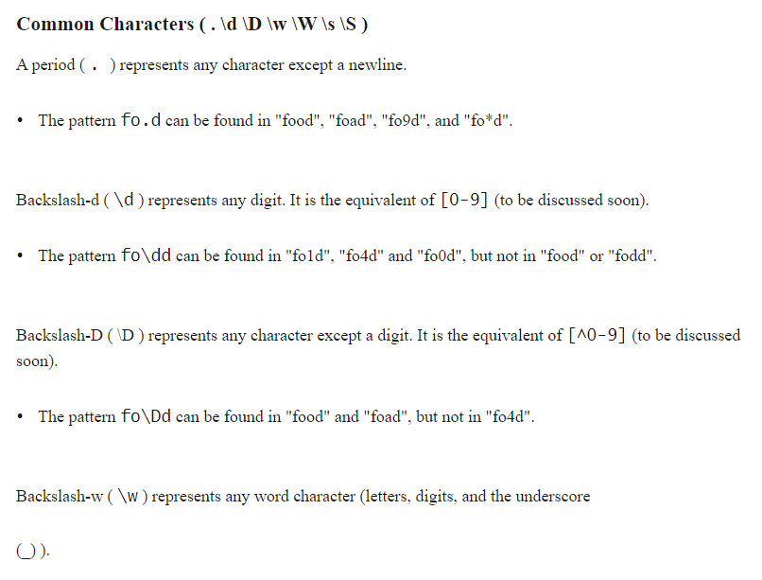

Slide 17
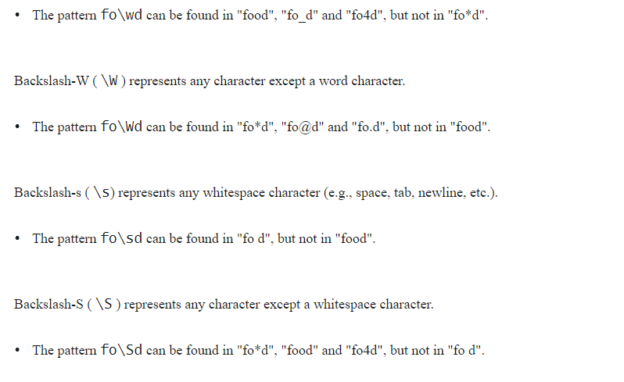

Slide 18
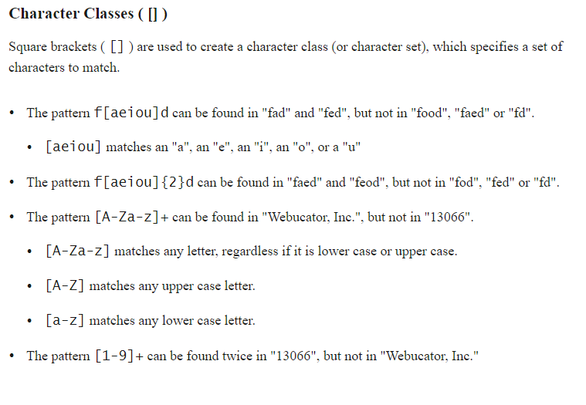

Slide 19
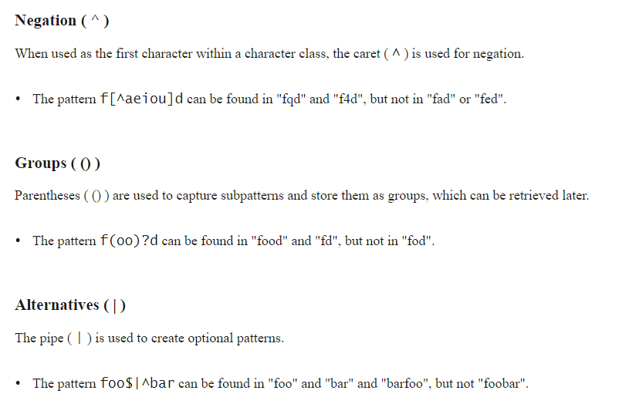

Slide 20
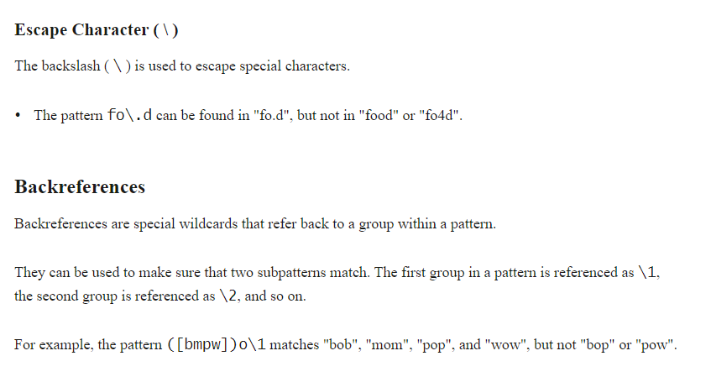

Slide 21
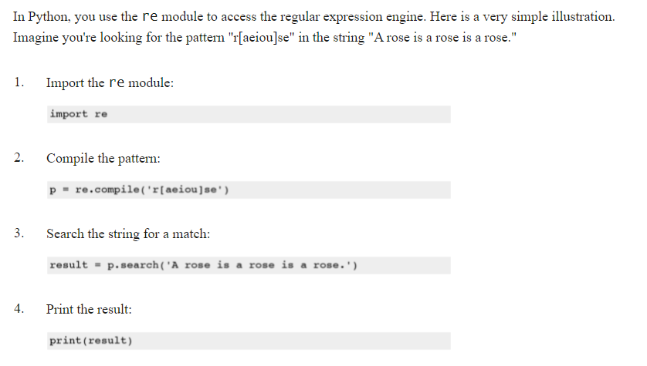
Using Python

Slide 22
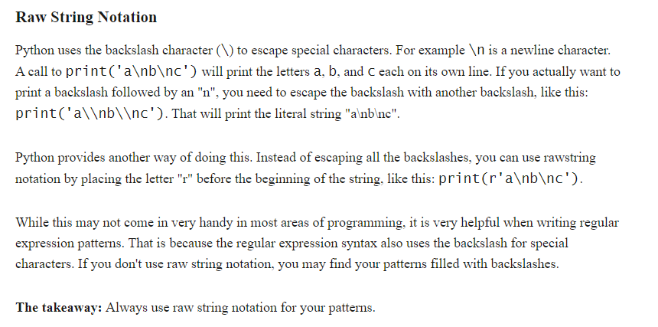
Raw String ‘r’

Slide 23
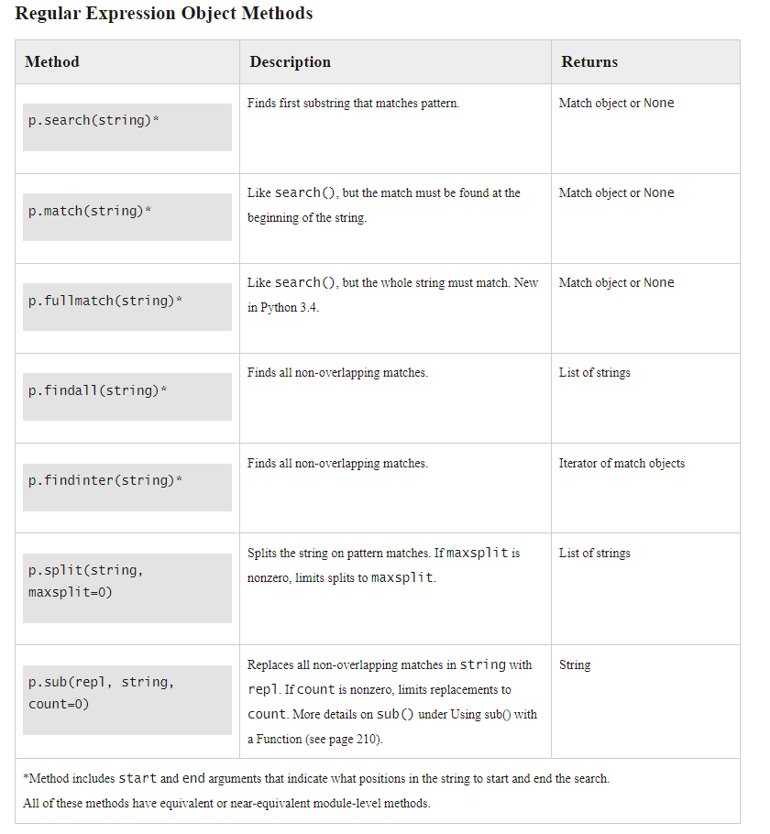

Slide 24
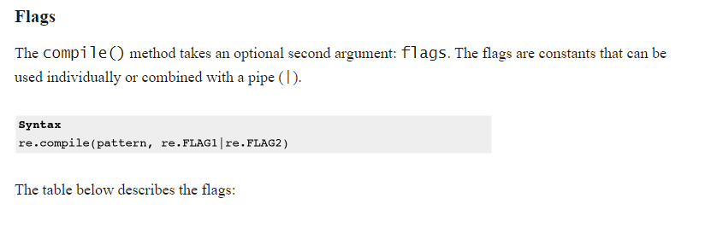
Patter match options, FLAGS

Slide 25
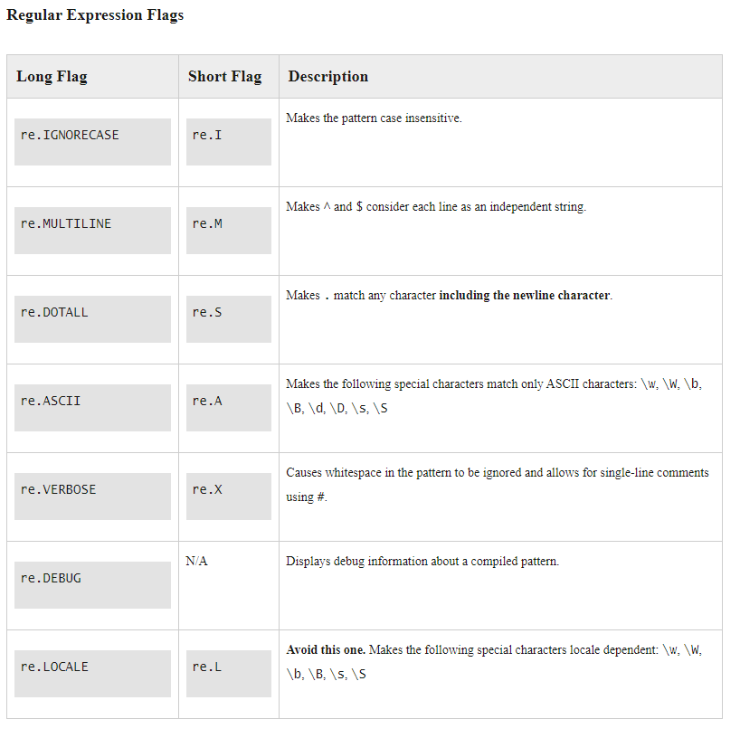

Slide 26
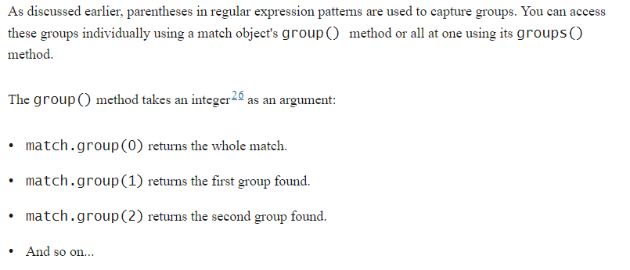
Groups

Slide 27
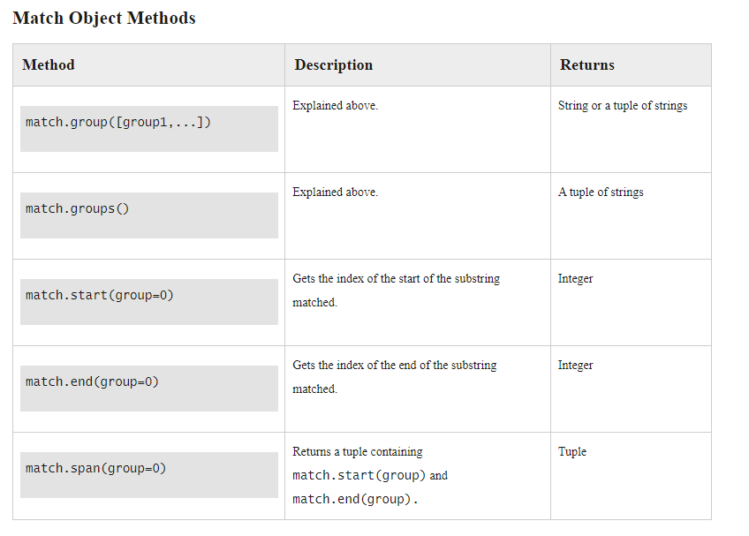

Slide 28
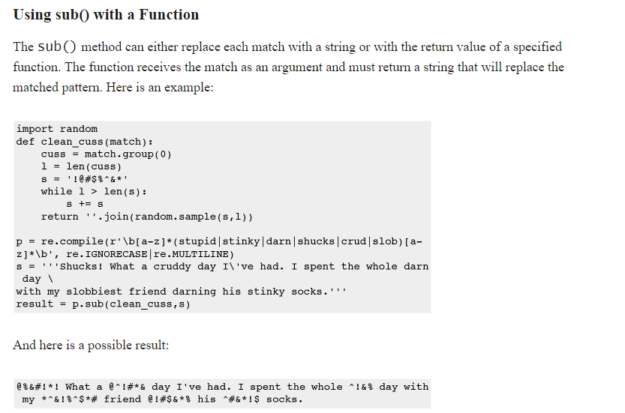

Slide 29
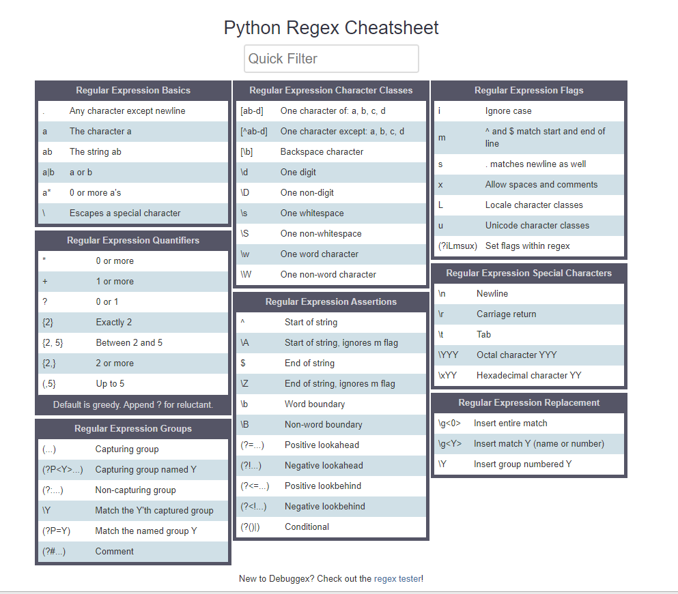
https://www.debuggex.com/cheatsheet/regex/python

Slide 30
Exercise
Check pythex site to test your pattern
\w+@\w+\.\w+
Read the lines from regex.txt
Check if they contain a valid email address
Print the results
BONUS: Put the emails randomly in the loremipsum file you made before and see if you can still find the emails.
BONUS2: Make multiple files and check all text files in a directory for email addresses

Slide 31
9 Unicode and Encoding
SKIPPED

Slide 32
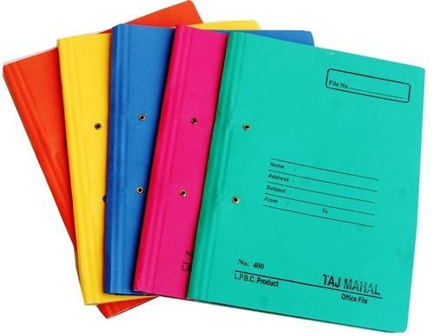

Slide 33
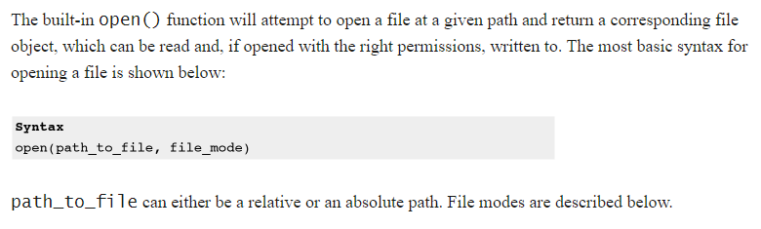
File Handling

Slide 34
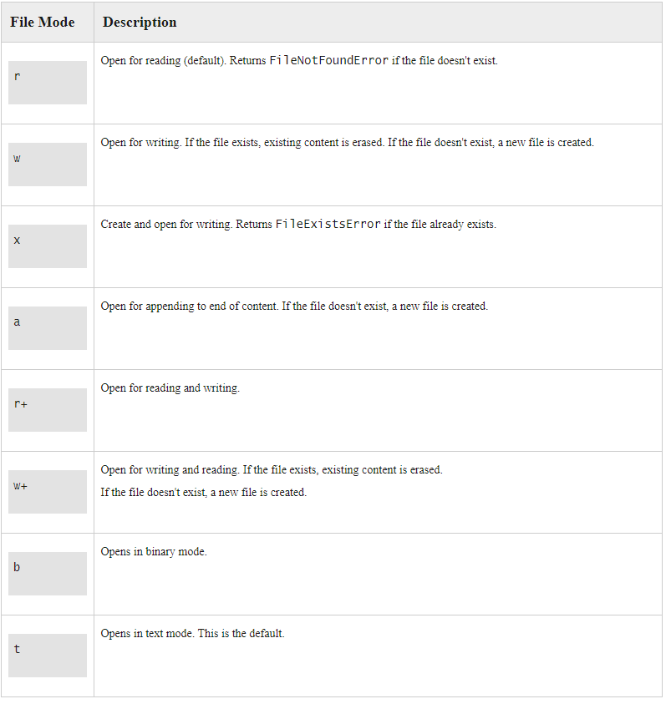


Slide 35
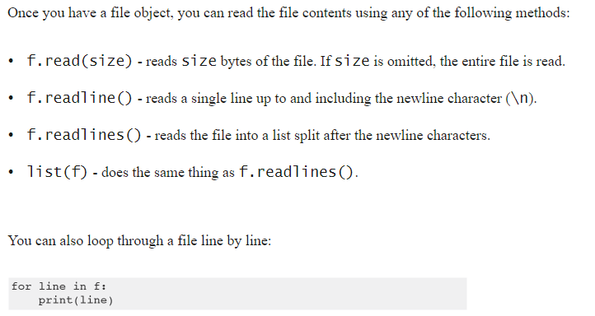
Reading Files

Slide 36
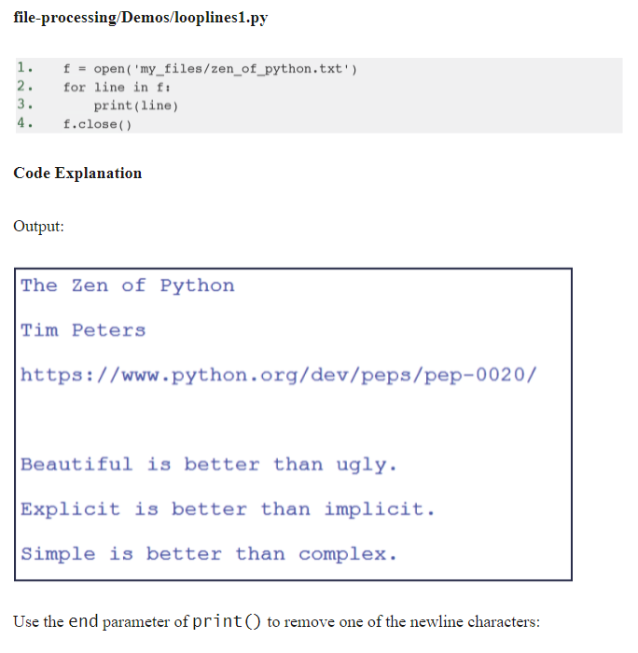

Slide 37
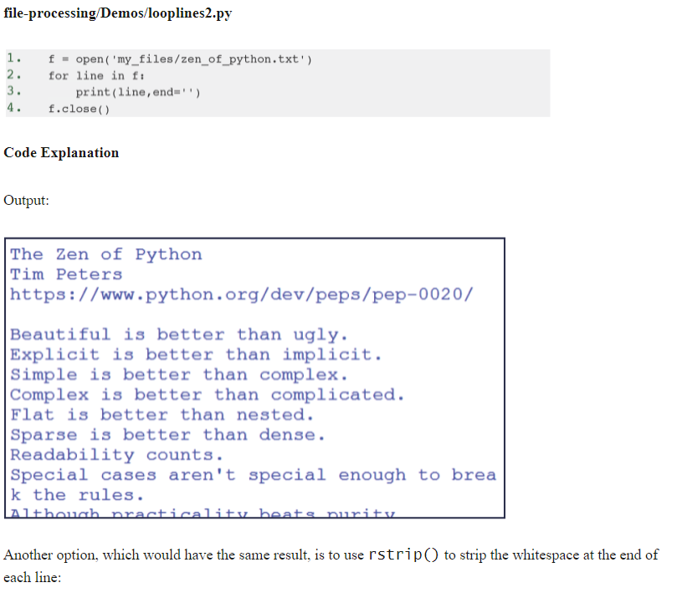

Slide 38
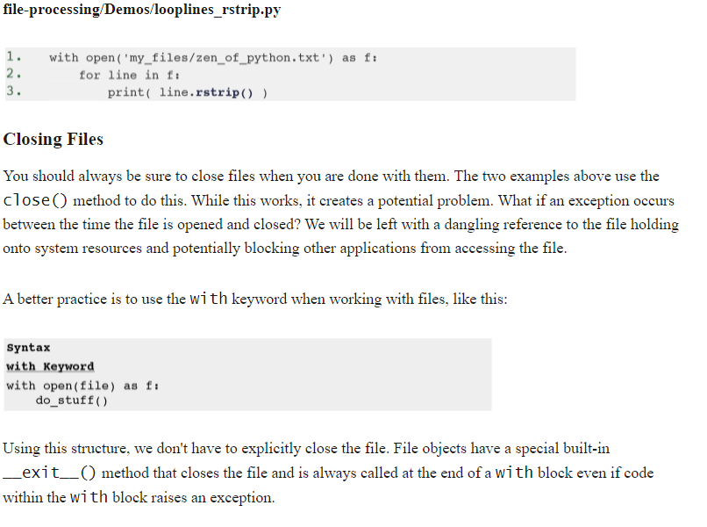

Slide 39

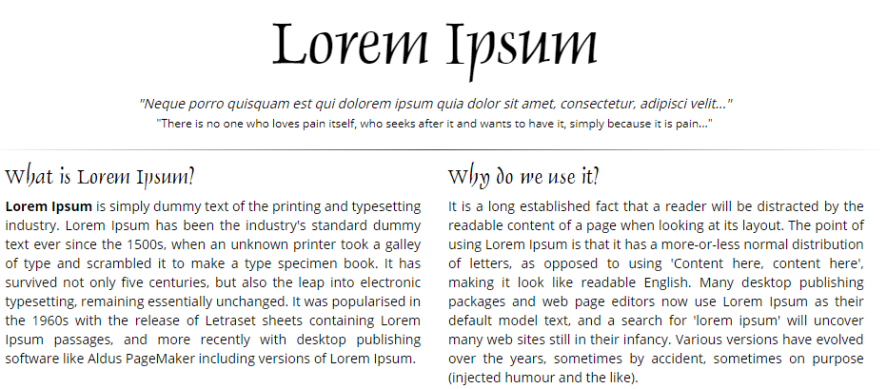
Exercise
f.seek(0)
Make a file with lipsum.org contents
Open the file
Use read, readline, readlines and the for to print (parts of) the contents

Slide 40
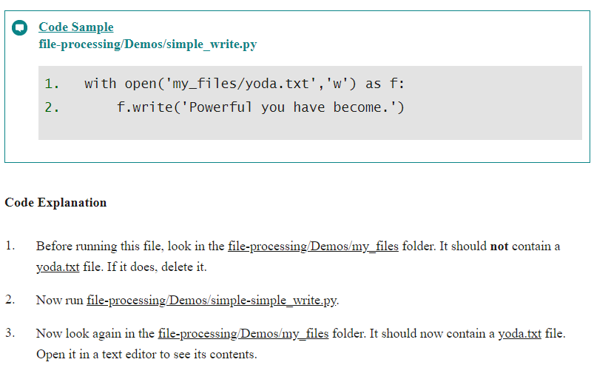
Writing to Files

Slide 41
os Methods
Import OS
Methods used to perform operations like change directory, make directory, etc

Slide 42
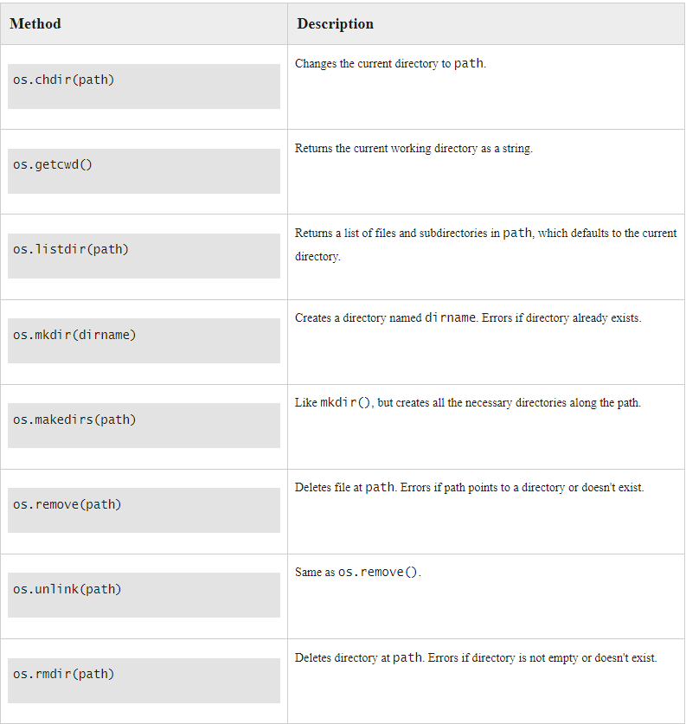
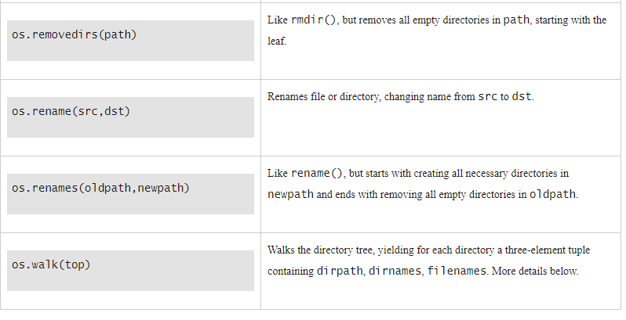

Slide 43
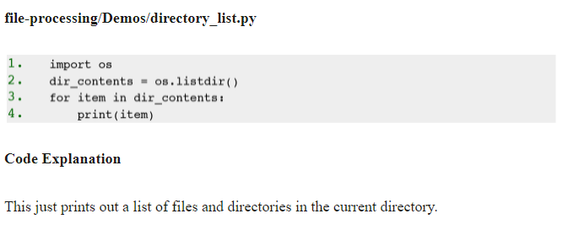
Examples – os.listdir()

Slide 44
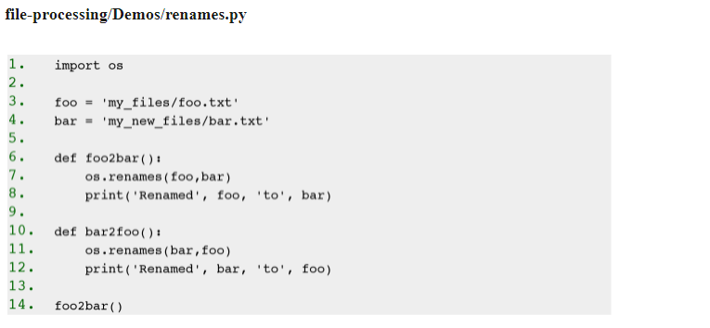
Examples – os.renames()

Slide 45
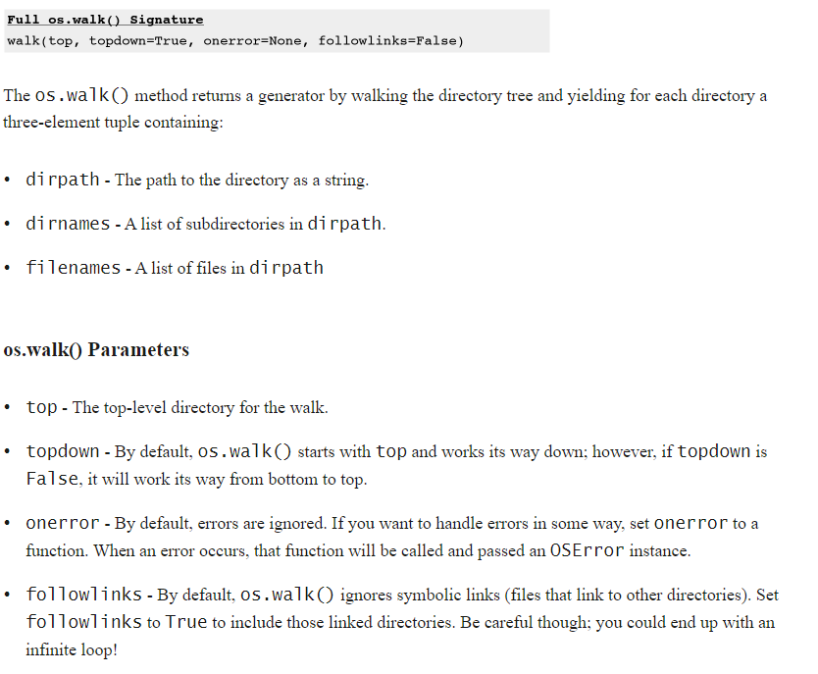
os.walk()

Slide 46
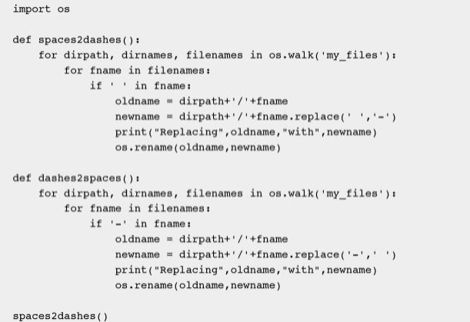

Slide 47
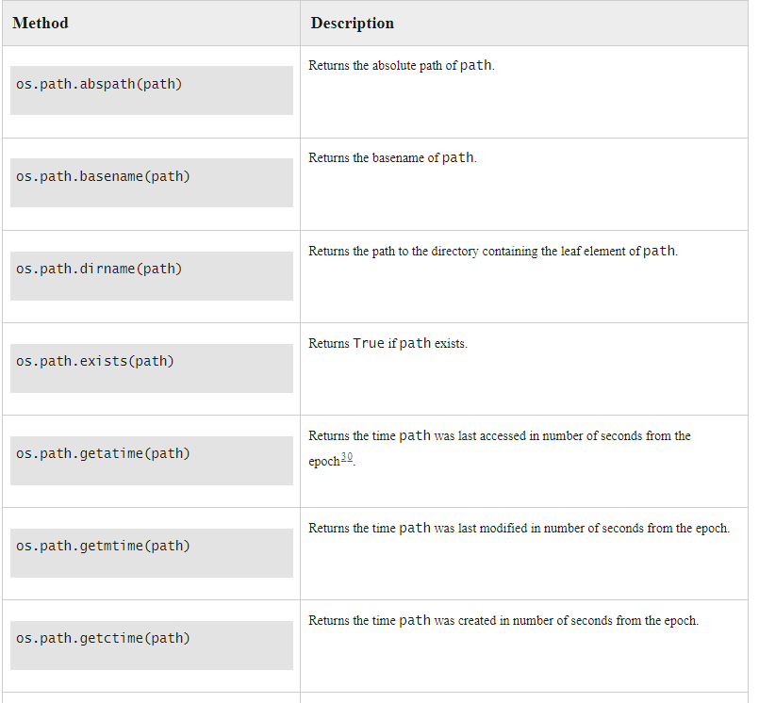
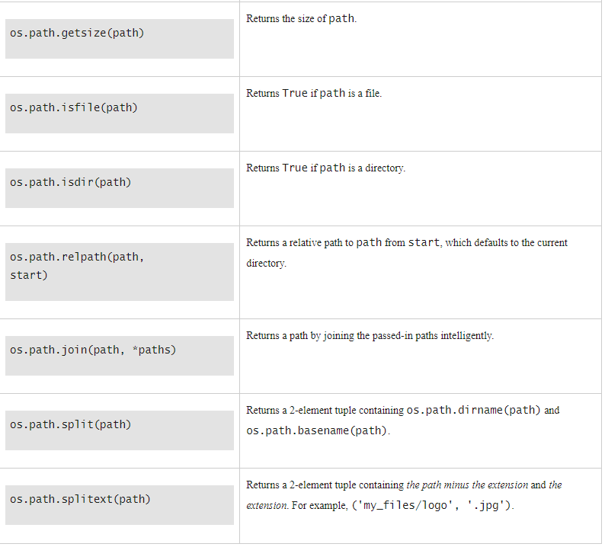
os.path()

Slide 48
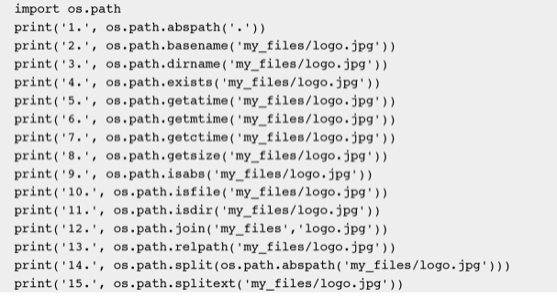
Check it
Exercise:
Make a logger that appends error messages to a logfile called log.txt
ERROR 234: Random error
def logerror(errornr=0, errortext = ‘random error’):
Notes:
https://www.pythontutorial.net/python-basics/python-read-csv-file/
pythontutorial.net/python-basics/python-write-csv-file/

